Slide 1

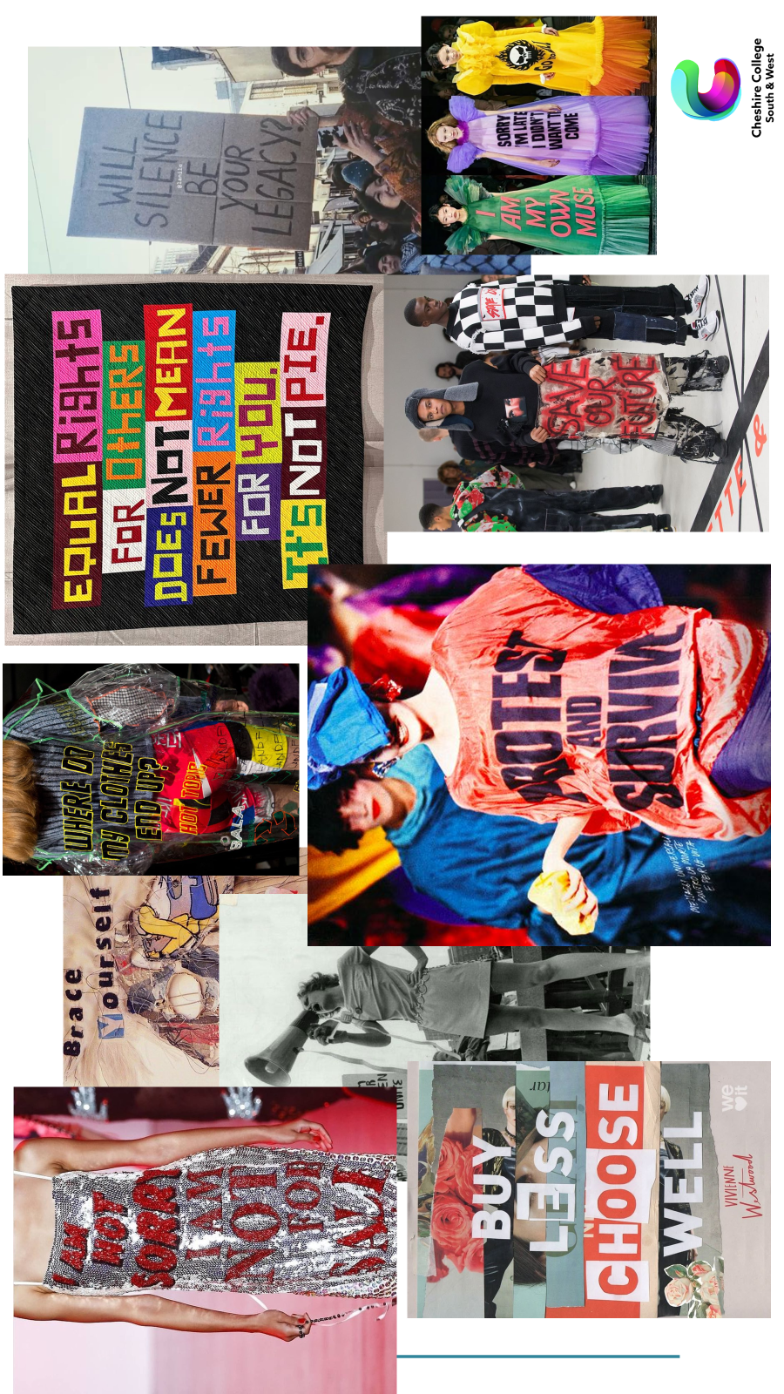

Project Brief
A1 Term 1 Project ‘Protest’
For your first project you will be exploring and experimenting with all the basics of Textiles- Print, Knit, Stitch, Dye and Weave.
Some of these techniques you may be familiar with, some of them not, either way you will be given the opportunity to develop and explore them in new ways.
In order to help with a theme you should explain your chosen theme for ‘Protest’. What would you protest? What is important? Could it be humorous?
Environmental protest- climate change
Education funding protest
Issues around feminism
Body Positivity
LGBTQ+ rights
Please beware of not offending others but please research and explain your choice thoroughly. You should include images to explain and even some primary images if possible. These images should be printed out, and form part of your first Mood boards.
Pre course task-
Purchase an A3 hard back sketchbook.
Choose a ‘Protest’ theme.
Start to gather fabric scraps, papers, threads, paints, materials and drawing mediums with colours relating to your theme.
Have all of these with you for your first lesson and every lesson there after.
Protest

Slide 2
