Slide 1

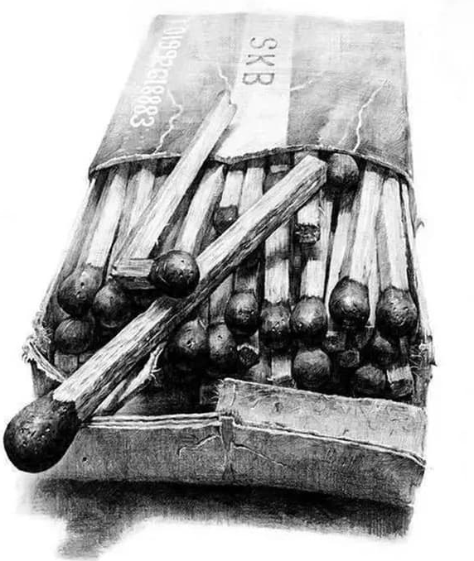

Component 1:
Personal Investigation ‘Observation’
Observation – Bridging Task

Slide 2
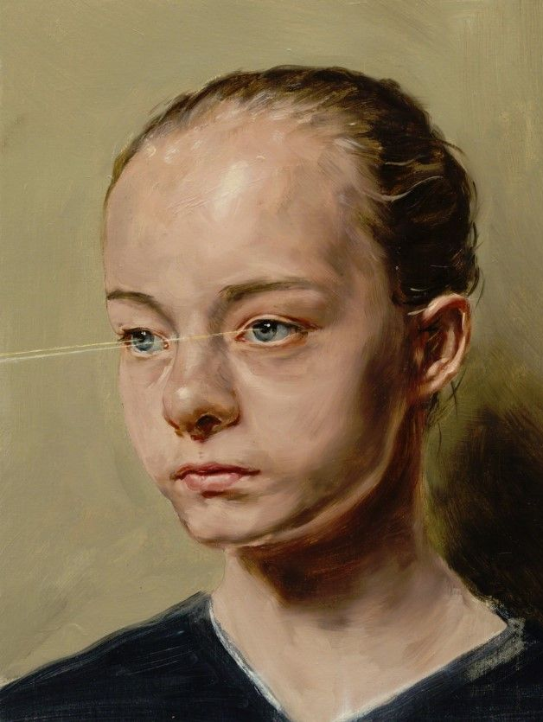
Component 1:
Personal Investigation ‘Observation’
Observation
1 of 2 noun
ob·​ser·​va·​tion
Synonyms of observation
A: an act or instance of observing a custom, rule, or law
B: an act of recognizing and noting a fact or occurrence often involving measurement with instruments weather observations
C: a record or description so obtained Scientific observations were sent to the committee.
Observation
2 of 2 adjective
: designed for use in viewing something (such as scenery) or in making observations

Slide 3
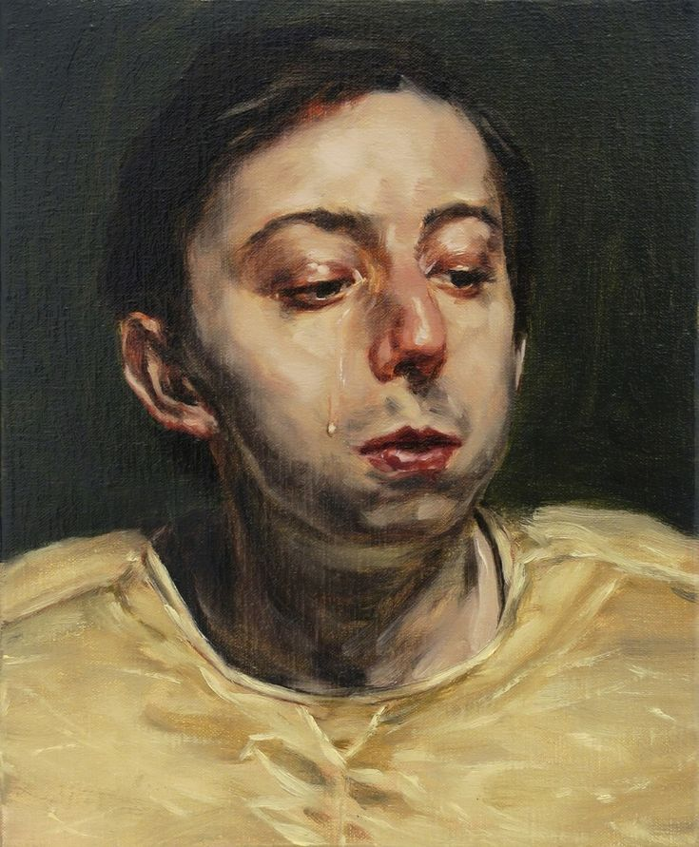
Component 1:
Personal Investigation ‘Observation’
For your first project you will be exploring and experimenting with all the basics of Fine Art.
Some of these techniques you may be familiar with, some of them not, either way you will be given the opportunity to develop and explore them in new ways.
You will generate a portfolio of evidence that will be focused on exploiting techniques and mediums to a high degree of skill.
You will submit this evidence in annotated sketchbook alongside your final outcome.

Slide 4
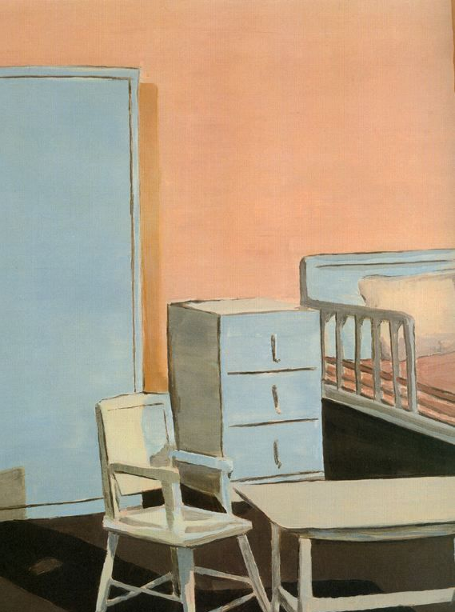
Component 1:
Personal Investigation ‘Observation’ (Deadline 31/1/28)
As long as you are observing the subject you can produce work based on pretty much any theme. You can work from your own primary reference only (YOU CANNOT WORK FROM SECONDARY).
In workshops we will cover the following major themes:
Objects
Scenes
People

Slide 5
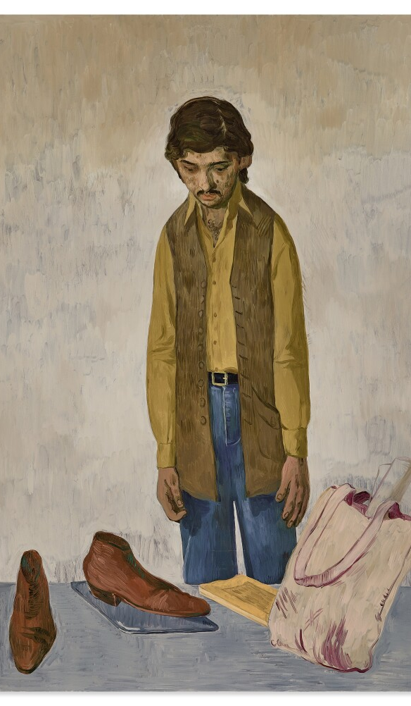
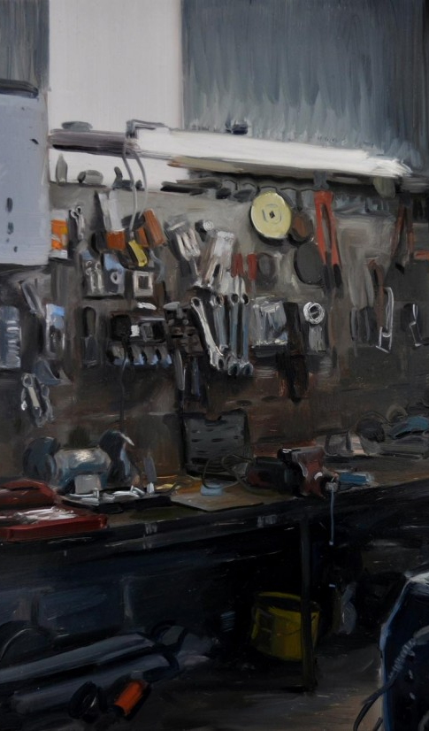
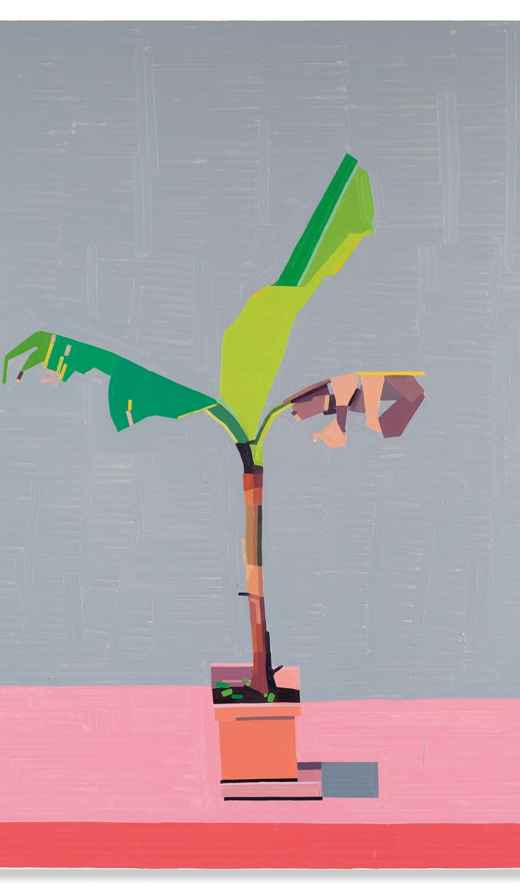

Slide 6
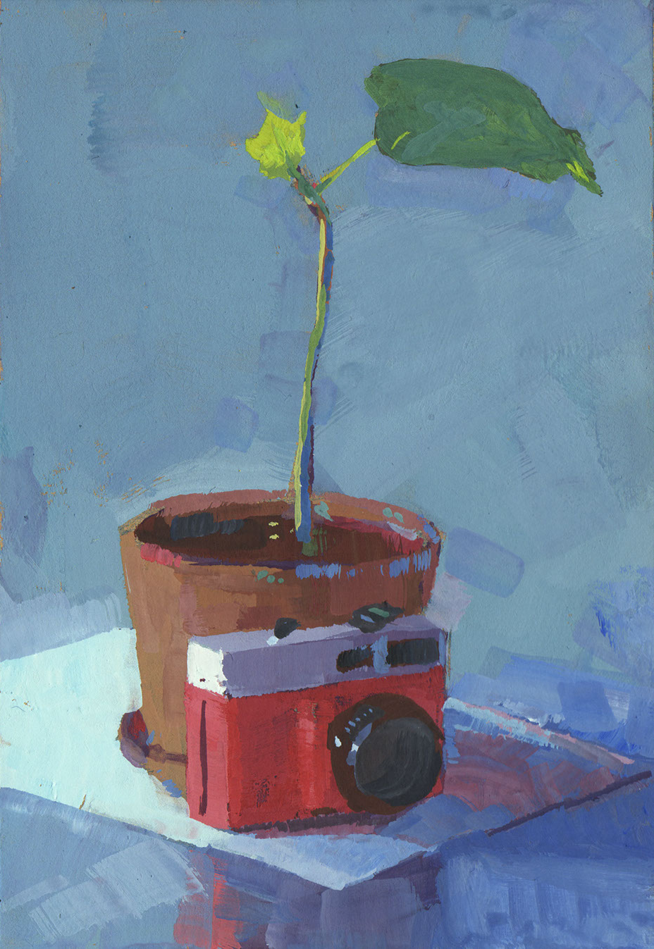
Bridging Task
For your start in September, you should have completed the following exercises in an A4 Sketchbook. These will engage your mental and physical observational skills in preparation for next year.
90minute drawing session (Any media).
X10 - 1 minute observational drawings
X10 - 2 minute observational drawings
X6 - 5 minute observational drawings
X2 - 10 minute observational drawings
X1 - 30 minute observational drawing
Complete this activity at least three times, (no more than once a day).
All you need is a stopwatch(Phone), pen/pencil and a sketchbook. It is important to stick to the time limits, if time runs out and you’ve not finished, that’s ok, you’re not expected to. The shorter times are designed to improve your speed.
These can be based on any object or location you can see, no secondary images please.

Slide 7
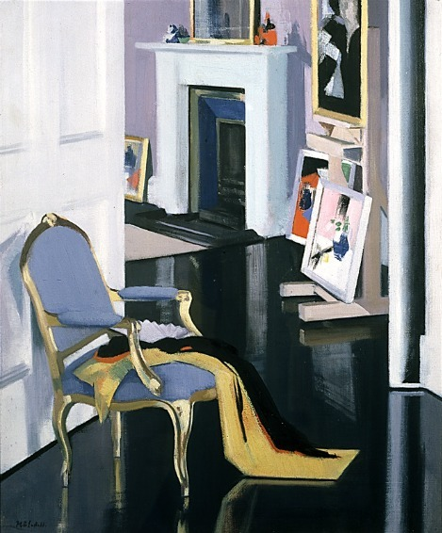
Component 1:
Personal Investigation ‘Observation’ (Deadline 31/1/28)
Develop ideas through sustained and focused investigations informed by contextual and other sources, demonstrating analytical and critical understanding. – AO1
Explore and select appropriate resources, media, material, techniques and processes, reviewing and reviewing ideas as work develops. – AO2
Record ideas, observations and insights relevant to intentions, reflecting critically on work and progress. - AO3
Present a personal and meaningful response that realises intentions and, where appropriate, makes connections between visual and other elements. - AO4
AO1, AO2, AO3, AO4 = EQUAL WEIGHTING (25%)

Slide 8
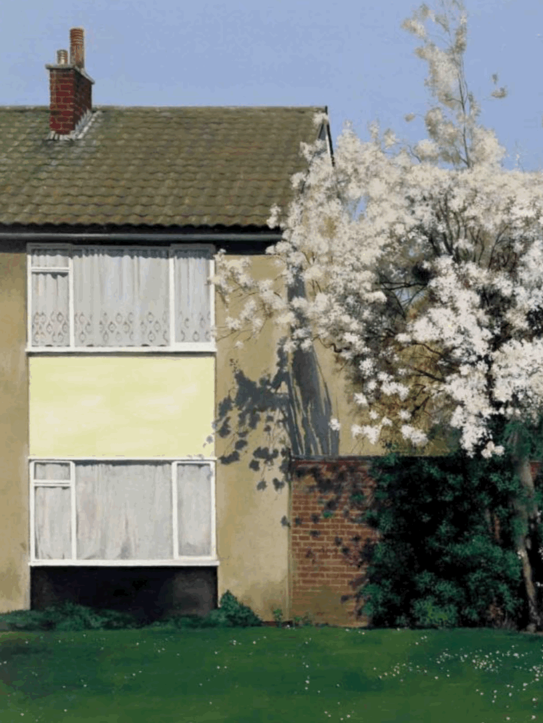
Component 1:
Personal Investigation ‘Observation’ (Deadline 31/1/28)
Kit List:
X2 A3 Sketchbooks
Pencils, Fine liners
Oil paints – Winsor & Newton x6 pack
Acrylic sets
Brushes – Round or flats of various sizes
Anything else art related is beneficial and will vary between individuals depending on what your focus of your work will be.

Slide 9
Component 1:
Personal Investigation ‘Observation’
Evidence
You must submit a sketchbook containing the following:
Artist pages + Responses – AO1 (25%)
Experiments – AO2 (25%)
Developments – AO2 (25%)
Final outcome – AO4 (25%)
Evaluation – AO3 (25%)

