Slide 1
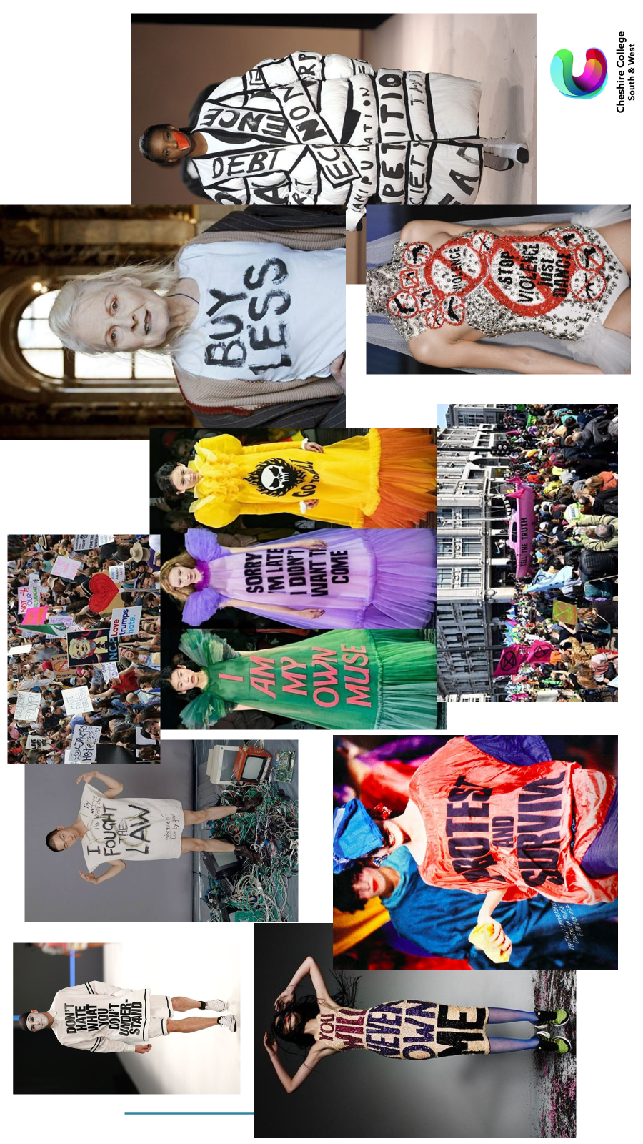
Project Brief
A1 Term 1 Project ‘Protest’
For your first project you will be exploring and experimenting with all the basics of Textiles- Print, Knit, Stitch, Dye and Weave.
Some of these techniques you may be familiar with, some of them not, either way you will be given the opportunity to develop and explore them in new ways.
In order to help develop a consistent presentation approach, you should research and explore the theme of ‘Protest’. Investigate different types of protest, for example, boycotting something, mass people protests and especially protest themes and genres used by artists and designers. Save and store information and if possible, take some primary images of anything relevant you encounter over the summer. These images will be printed out, and form part of your first Mood boards.
Pre course task-
Purchase an A3 hard back sketchbook.
Explore themes around ‘Protest’
Start to gather fabric scraps, papers, threads, paints, materials and drawing mediums with colours relating to your theme.
Have all of these with you for your first lesson and every lesson there after.
Protest

Slide 2
